Slide 3
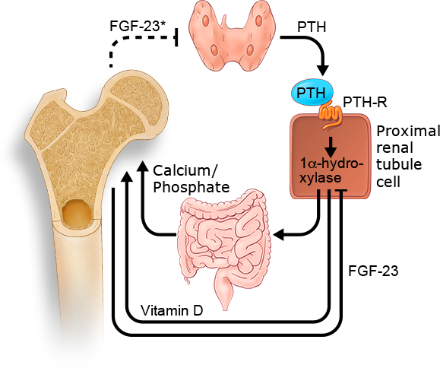
Parathyroid Hormone
Parathyroid hormone (PTH) is secreted by the parathyroid gland and maintains calcium homeostasis¹
Endogenous PTH stimulates both bone formation and bone resorption¹
Adapted from Blau JE, et al. Rev Endocr Metab Disord.
2015; In press.
*FGF23 suppression on the parathyroid gland was reported
in in vitro studies only
¹ Bergwitz C, et al. Ann Rev Med. 2010;61:91-104.

Slide 6
Calcium/Vitamin D
Calcium homeostasis is regulated by PTH and
maintained by absorption of dietary calcium in the intestine, reabsorption in the kidney, and release
from bone¹
Vitamin D, produced by the enzyme 1α-hydroxylase, indirectly acts on bone homeostasis by suppressing
PTH and increasing intestinal absorption of calcium
and phosphate¹
Adapted from Blau JE, et al. Rev Endocr Metab Disord.
2015; In press.
*FGF23 suppression on the parathyroid gland was reported
in in vitro studies only
¹ Lieben L, et al. Best Pract Res Clin Endocrinol Metab. 2011;25:561-572.

Slide 9
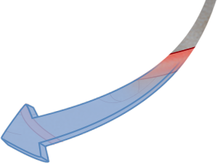
Phosphate
Phosphate homeostasis is maintained by absorption
of dietary phosphate in the intestine, reabsorption by the kidney, and movement of phosphate between the extracellular fluid space and the bone and soft tissue¹
The majority of phosphate retained in the body
is deposited in bone as calcium-phosphate
hydroxyapatite crystals²
Chronic serum phosphate deficiency results in impaired bone mineralization, rickets, and osteomalacia¹
¹ Berndt T, et al. Annu Rev Physiol. 2007;69:341-359.
² Farrow EG, et al. Nat Rev Nephrol. 2010;6:207-217.

Slide 12

FGF-23
Fibroblast growth factor 23 (FGF-23) is synthesized and secreted by osteocytes.¹ FGF-23 is upregulated by vitamin D and inhibits synthesis of vitamin D in a
negative feedback loop.^{1, 2} FGF-23 is a phosphaturic hormone that regulates renal phosphate reabsorption
and bone mineralization¹
Adapted from Blau JE, et al. Rev Endocr Metab Disord.
2015; In press.
*FGF23 suppression on the parathyroid gland was reported
in in vitro studies only
¹ Martin A, et al. Endocrine FGFs and Klothos. Austin, TX: Landes Bioscience;2012:65-83.
² Liu S, et al. J Am Soc Nephrol. 2006;17:1305-1315.

Slide 15

Estrogen
Estrogen regulates bone metabolism by inhibiting
bone remodeling, stimulating osteoclast apoptosis,
and promoting osteoblast survival¹
Estrogen deficiency has been identified as the cause of bone loss in postmenopausal women and aging men²
¹ Khosla S, et al. J Bone Miner Res. 2011;26:441-451.
² Riggs BL, et al. J Bone Miner Res. 1998;13:763-773.

Slide 18

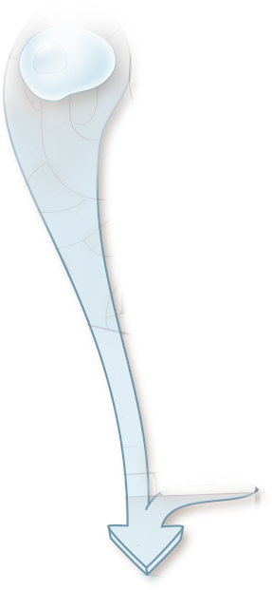
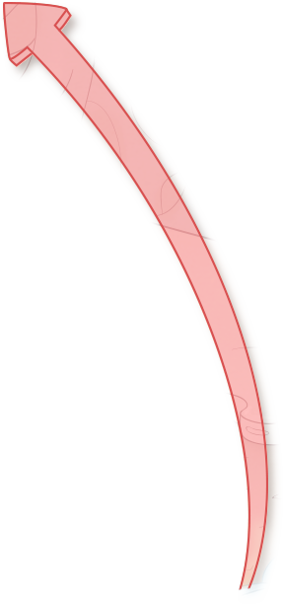
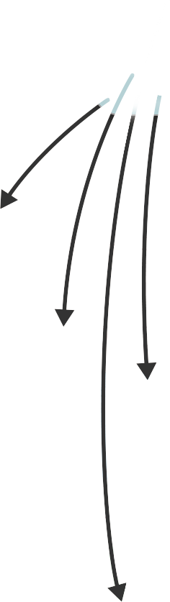


Osteoblast precursor
Osteoblasts
Osteoblasts, which originate from mesenchymal stem cells, synthesize and secrete proteins that regulate extracellular matrix formation and mineral deposition¹
Bone formation begins when osteoblasts lay down osteoid, which becomes mineralized into new bone¹
OPG
Sclerostin
Osteoblast
Osteocyte
¹ Manolagas SC. Endocrine Reviews. 2000;21:115-137.

Slide 21

Osteoprotegerin
Osteoblasts produce a glycoprotein called osteoprotegerin (OPG), which binds to RANKL and prevents it from binding to RANK¹
¹ Hofbauer LC, et al. JAMA. 2004;292:490-495..

Slide 24


Osteoblast precursor
RANKL
Osteoblasts, osteocytes, and T-cells produce RANKL¹, which binds to and activates its receptor, RANK, on immature and mature osteoclasts²
Binding of RANKL to RANK promotes osteoclast formation, function and survival²
OPG
Sclerostin
Osteoblast
Osteocyte
¹ Nakashima T, et al. Nat Med. 2011;17:1231-1234.
² Dempster DW, et al. Clin Thera. 2012; 34:521-536.

Slide 27
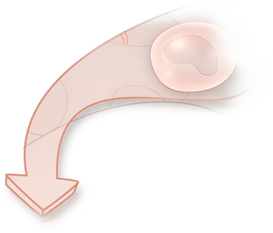

Osteoclasts
Osteoclasts are large, multi-nucleated cells derived from monocyte/macrophage precursors¹
Osteoclasts attach to bone matrix, then secrete acid and enzymes that degrade bone¹
¹ Boyle WJ, et al. Nature. 2003;423:337-342.

Slide 30
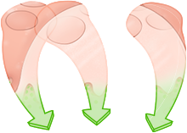
Cathepsin K
Cathepsin K is a cysteine protease that is highly and selectively expressed in osteoclasts¹
Active proteases released from osteoclasts into the resorption lacunae degrade bone-matrix proteins and
type I and type II collagen^{2–4}
¹ Drake FH, et al. J Biol Chem. 1996;271:12511-12516.
² Baron R, et al. J Cell Bio. 1985;101:2210-2222.
³ Bossard MJ, et al. J Biol Chem. 1996;271:12517-12524.
⁴ Kafienah W, et al. Biochem J. 1998;331:727-732.

Slide 33
Bone Matrix
Osteoblasts secrete collagen, which composes the majority of the organic component of bone¹
The inorganic bone matrix consists primarily of mineralized calcium and phosphate¹
¹ Downey PA, et al. Phys Ther. 2006;86:77-91.

Slide 36

Osteoblast precursor
Osteocytes
Osteocytes are terminally-differentiated osteoblasts embedded in the bone matrix¹
Osteocytes respond to mechanical and environmental stimuli to modulate the process of bone formation
and resorption¹
OPG
Sclerostin
Osteoblast
Osteocyte
¹ Bellido T. Calc Tiss Int. 2014;94:25-34.

Slide 39


Osteoblast precursor
Wnt
Wnt proteins are key signaling molecules in tissue development and regeneration¹
Wnt binds to co-receptors LRP 5/6 and frizzled, forming
a complex that stabilizes intracellular β-catenin. Stabilized β-catenin translocates to the nucleus and mediates
gene transcription, resulting in increased bone formation¹
Canonical Wnt signaling increases bone formation through multiple mechanisms:
Increased differentiation of mesenchymal
stem cells to osteoblasts²
Increased osteoblast activity³
Stimulation of the conversion of bone lining
cells into osteoblasts⁴
Regulation of osteoblast and osteoclast activity via
osteocyte signaling^{5, 6}
OPG
Sclerostin
Osteoblast
¹ MacDonald BT, et al. Developmental Cell. 2009;17:9-26.
² Hu H, et al. Development. 2005;132:49-60.
³ Kato M, et al. J Cell Biol. 2002;157:303-314.
⁴ Nioi P, et al. J Bone Miner Res. 2015;30:1457-1467.
⁵ Tu X, et al. Proc Natl Acad Sci. 2015;112:e478-486.
⁶ Kramer I, et al. Mol Cell Bio. 2010;30:3071-3085.
Osteocyte

Slide 42
Osteoblast precursor
Sclerostin
Sclerostin is a protein secreted predominantly by osteocytes in bone¹
Sclerostin binds to low density lipoprotein
receptor-related proteins (LRP4, LRP5, LRP6) and
inhibits canonical Wnt-β-catenin signaling^{2, 3}
In human disease, loss-of-function mutations in the sclerostin gene (SOST) result in high bone mass phenotypes, e.g., sclerosteosis⁴
OPG
Sclerostin
Osteoblast
Osteocyte
¹ Winkler DG, et al. EMBO J. 2003;22:6267-6276.
² Li X, et al. J Biol Chem. 2005;280:19883-19887.
³ Choi HY, et al. PLoS One. 2009;4:e7390.
⁴ Balemans W, et al. Hum Molec Genet. 2001;10:537-543.

Slide 45
Osteocalcin
Osteocalcin is a calcium-binding protein secreted
primarily by mature osteoblasts and used as an osteoblastic-specific marker of bone formation¹
Recent evidence suggests that under-carboxylated osteocalcin has an endocrine role in the regulation of energy metabolism, e.g., via insulin²
¹ Hauschka PV, et al. Physiol Reviews. 1989; 69:990-1047.
² Ferron M, et al. Cell. 2010;142:296-308.

Slide 47
PTH-FGF23 Pathways
Adapted from Blau JE, et al. Rev Endocr Metab Disord.
2015; In press.
* FGF23 suppression on the parathyroid gland was
reported in in vitro studies only

Slide 48
Osteoblast precursor
PTH-FGF23 Pathways
OPG
Sclerostin
Osteoblast
Osteocyte
Adapted from Blau JE, et al. Rev Endocr Metab Disord.
2015; In press.
* FGF23 suppression on the parathyroid gland was
reported in in vitro studies only

Slide 50
PTH-FGF23 Pathways
Adapted from Blau JE, et al. Rev Endocr Metab Disord.
2015; In press.
* FGF23 suppression on the parathyroid gland was
reported in in vitro studies only

